Slide 1


Slide 2
Chapter
Vulnerability / Method to Fix
2. Find Offset
3. Find Libc Base Address
4. Find Gadget / Explanation
5. Obtain Remote Shell
6. Terminate without Crashing

Slide 3
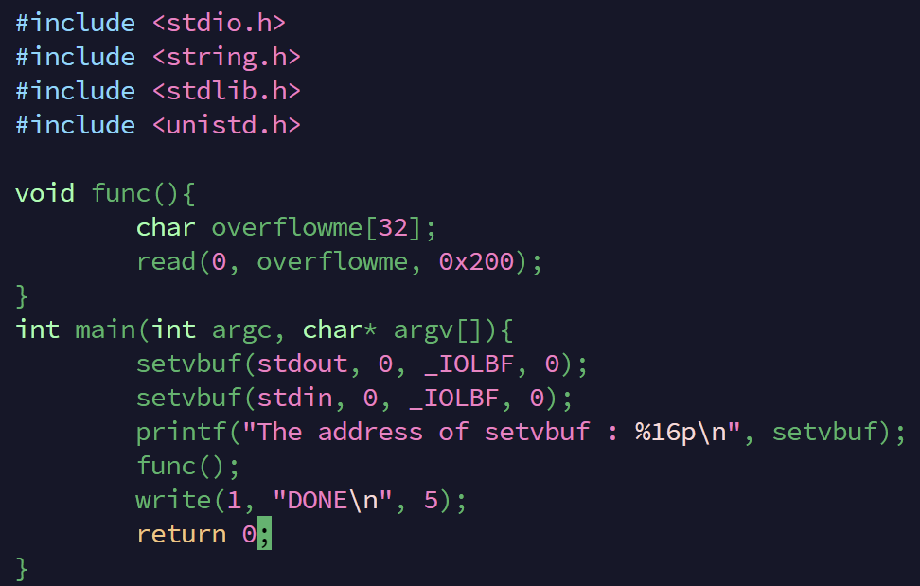
Vulnerability
size of overflowme(32 bytes)
<not match>
byte of read overflowme(512 bytes)

Slide 4
Stack:
1 2 3 … … 32
Read:
1 2 3 … … … … … 512
Stack Overflow!

Slide 5
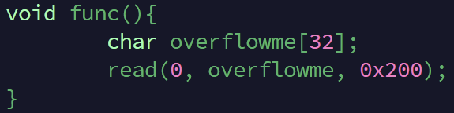
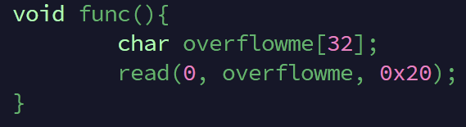
Fix

Slide 6
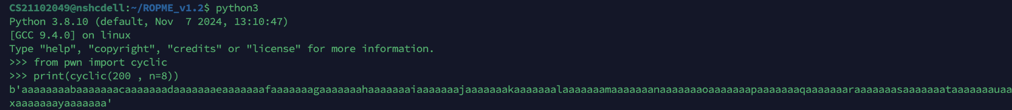
2. Find Offset
set the cyclic pattern
value to dump
debugging ropme file
find the function address and dump

Slide 7
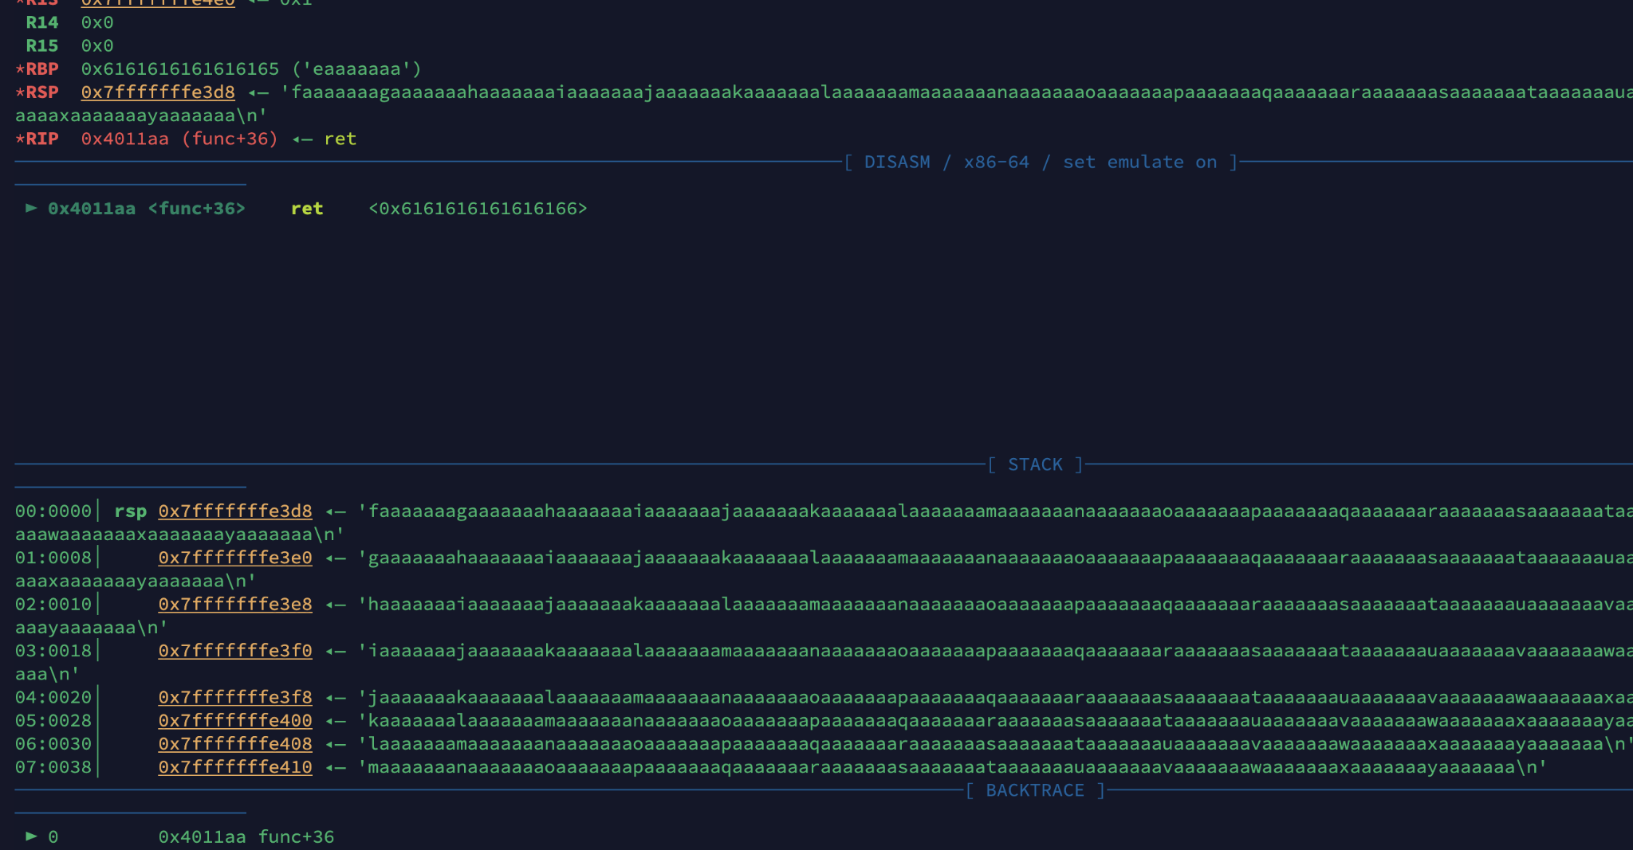
Crashed
0x6161616161616166

Slide 8
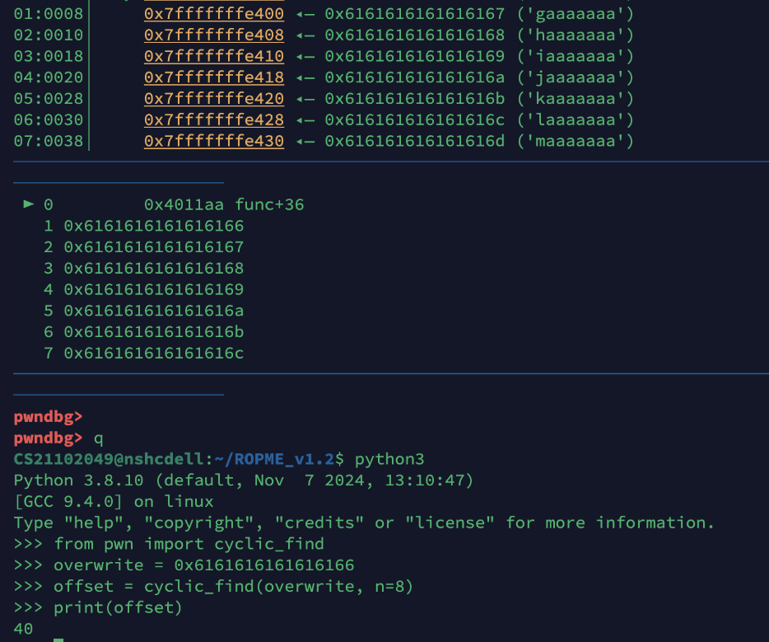
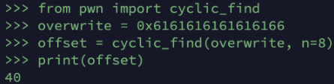
rip : 0x6161616161616166
offset = 40

Slide 9
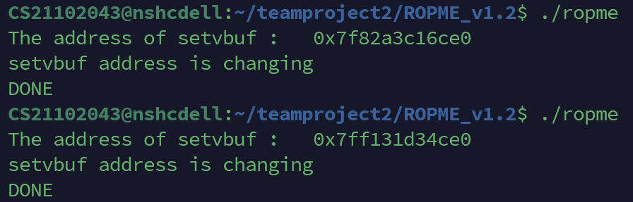
3. Find Libc Base Address
libc_base = setvbuf address - setvbuf offset
setvbuf offset is fixed
setvbuf address is changeable
whenever executing ropme file
Need to get a value dynamically

Slide 10
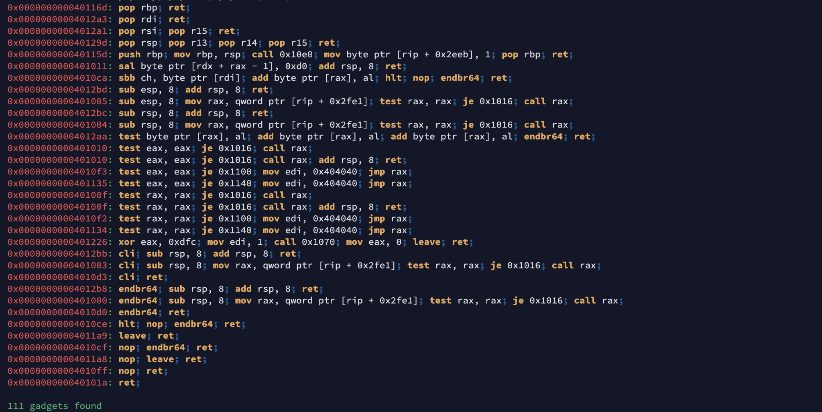
4. Find Gadget
‘ropper’ command
pop rdi; ret; address
: 0x4012a3
(return gadget)
ret address
:0x40101a
(to sort stack)

Slide 11
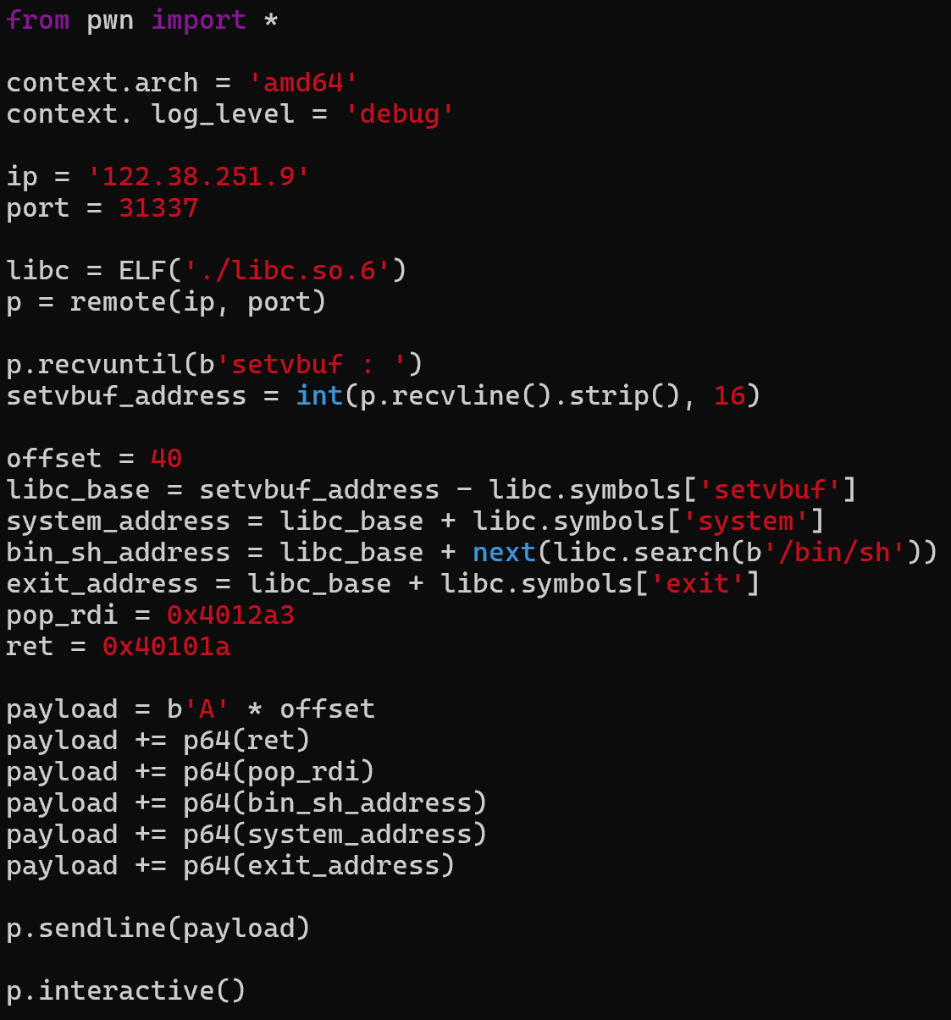
5. Obtain Remote Shell
Debug setting
remote setting
Processing to get libc address and access remote
Receiving changeable function address
Calculating real gadget address
Making payload
running payload

Slide 12
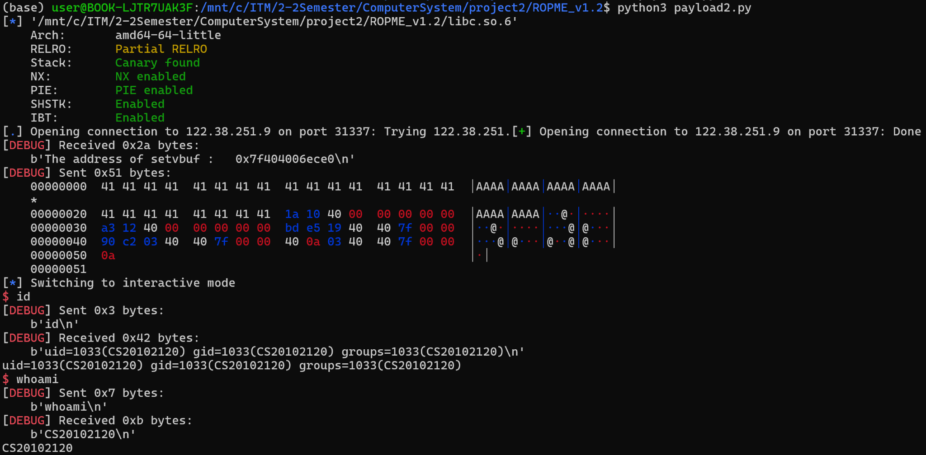
Commands are well activating

Slide 13
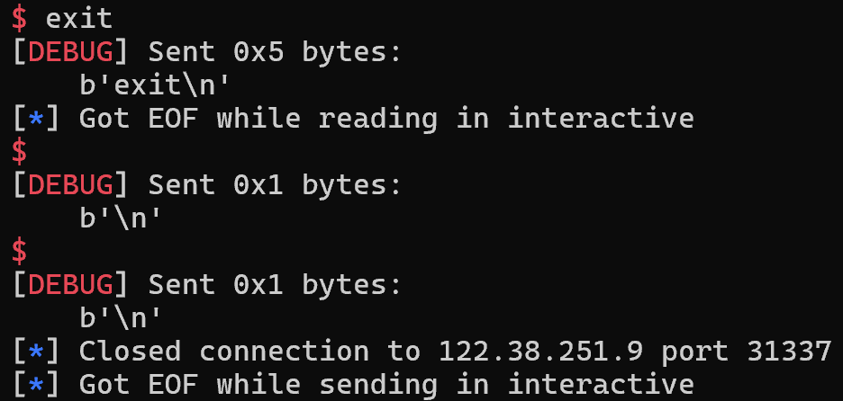
6. Terminate without Crashing
‘exit’ command is also well activating
finishing interactive
mode
After finishing, there is no ‘core.ropme’ file

Slide 14
Thank you

